Slide 1

Why No Booster? Analysis of People Who Received Vaccines But Not Booster
By: Bilal Mukhtar

Slide 2
Goal
To understand why those who received the vaccine chose not to get the booster

Slide 3
Context
As of right now, boosters are widely available for adults throughout the country
However, many still choose not to receive these boosters, even if they chose not to get the vaccine

Slide 4
Process
I looked at the 4 states that had the biggest difference between vaccine rate and booster rate to see if there was a common reason

Slide 5
Data
All data was sourced from the Household Pulse Survey (HPS) Week 46 release
Data used: Vaccination status, booster status, state, and reason for not getting the booster

Slide 6
Goal Formation
The goal came about from analyzing a series of maps contain vaccination rate, booster rate, and difference between vaccination and booster rate
These maps were formed based on the data set using the Folium python package

Slide 7
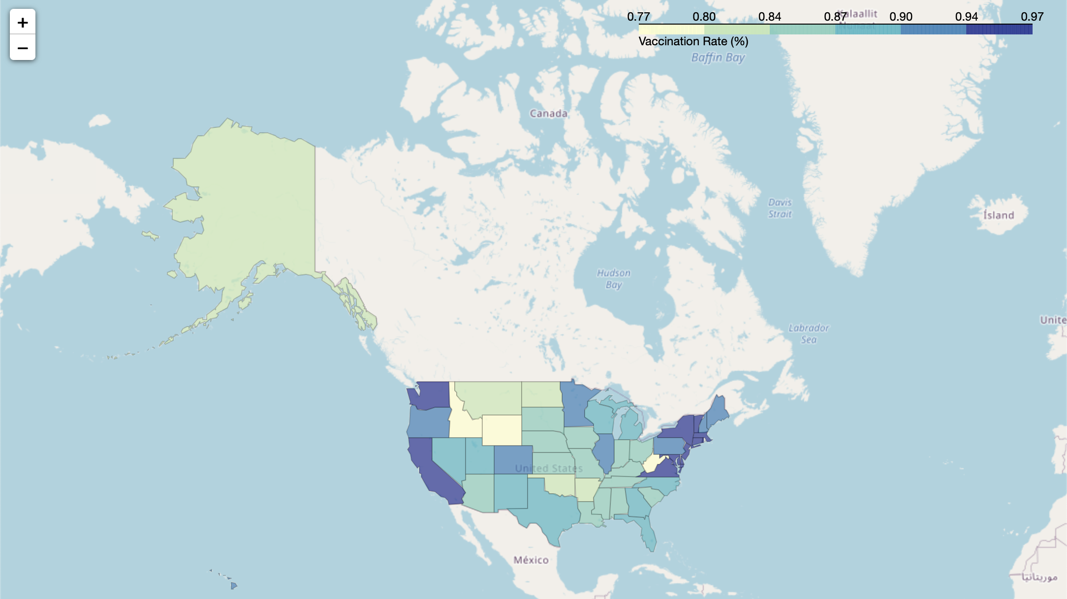
Maps

Slide 8
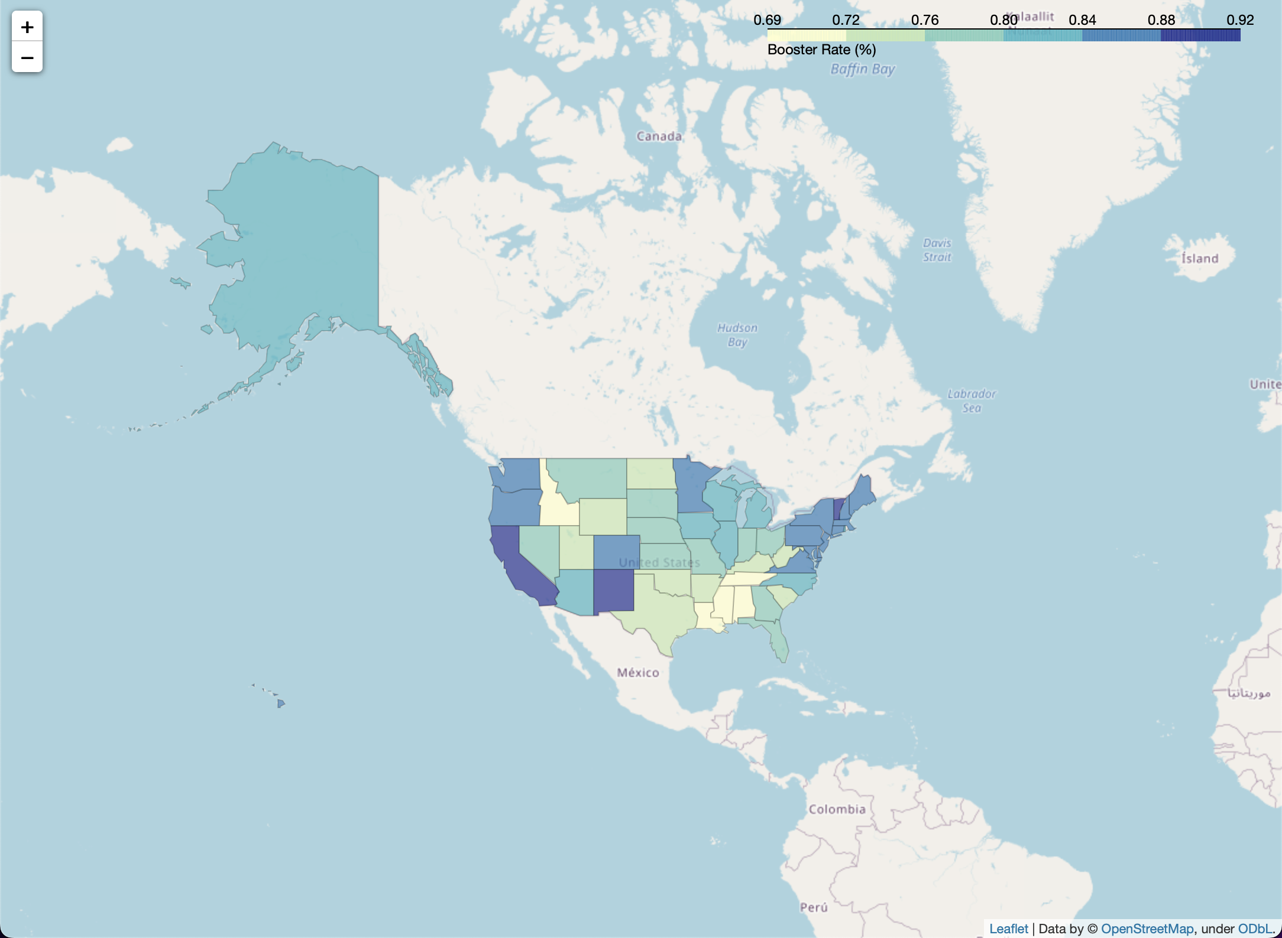
Maps

Slide 9
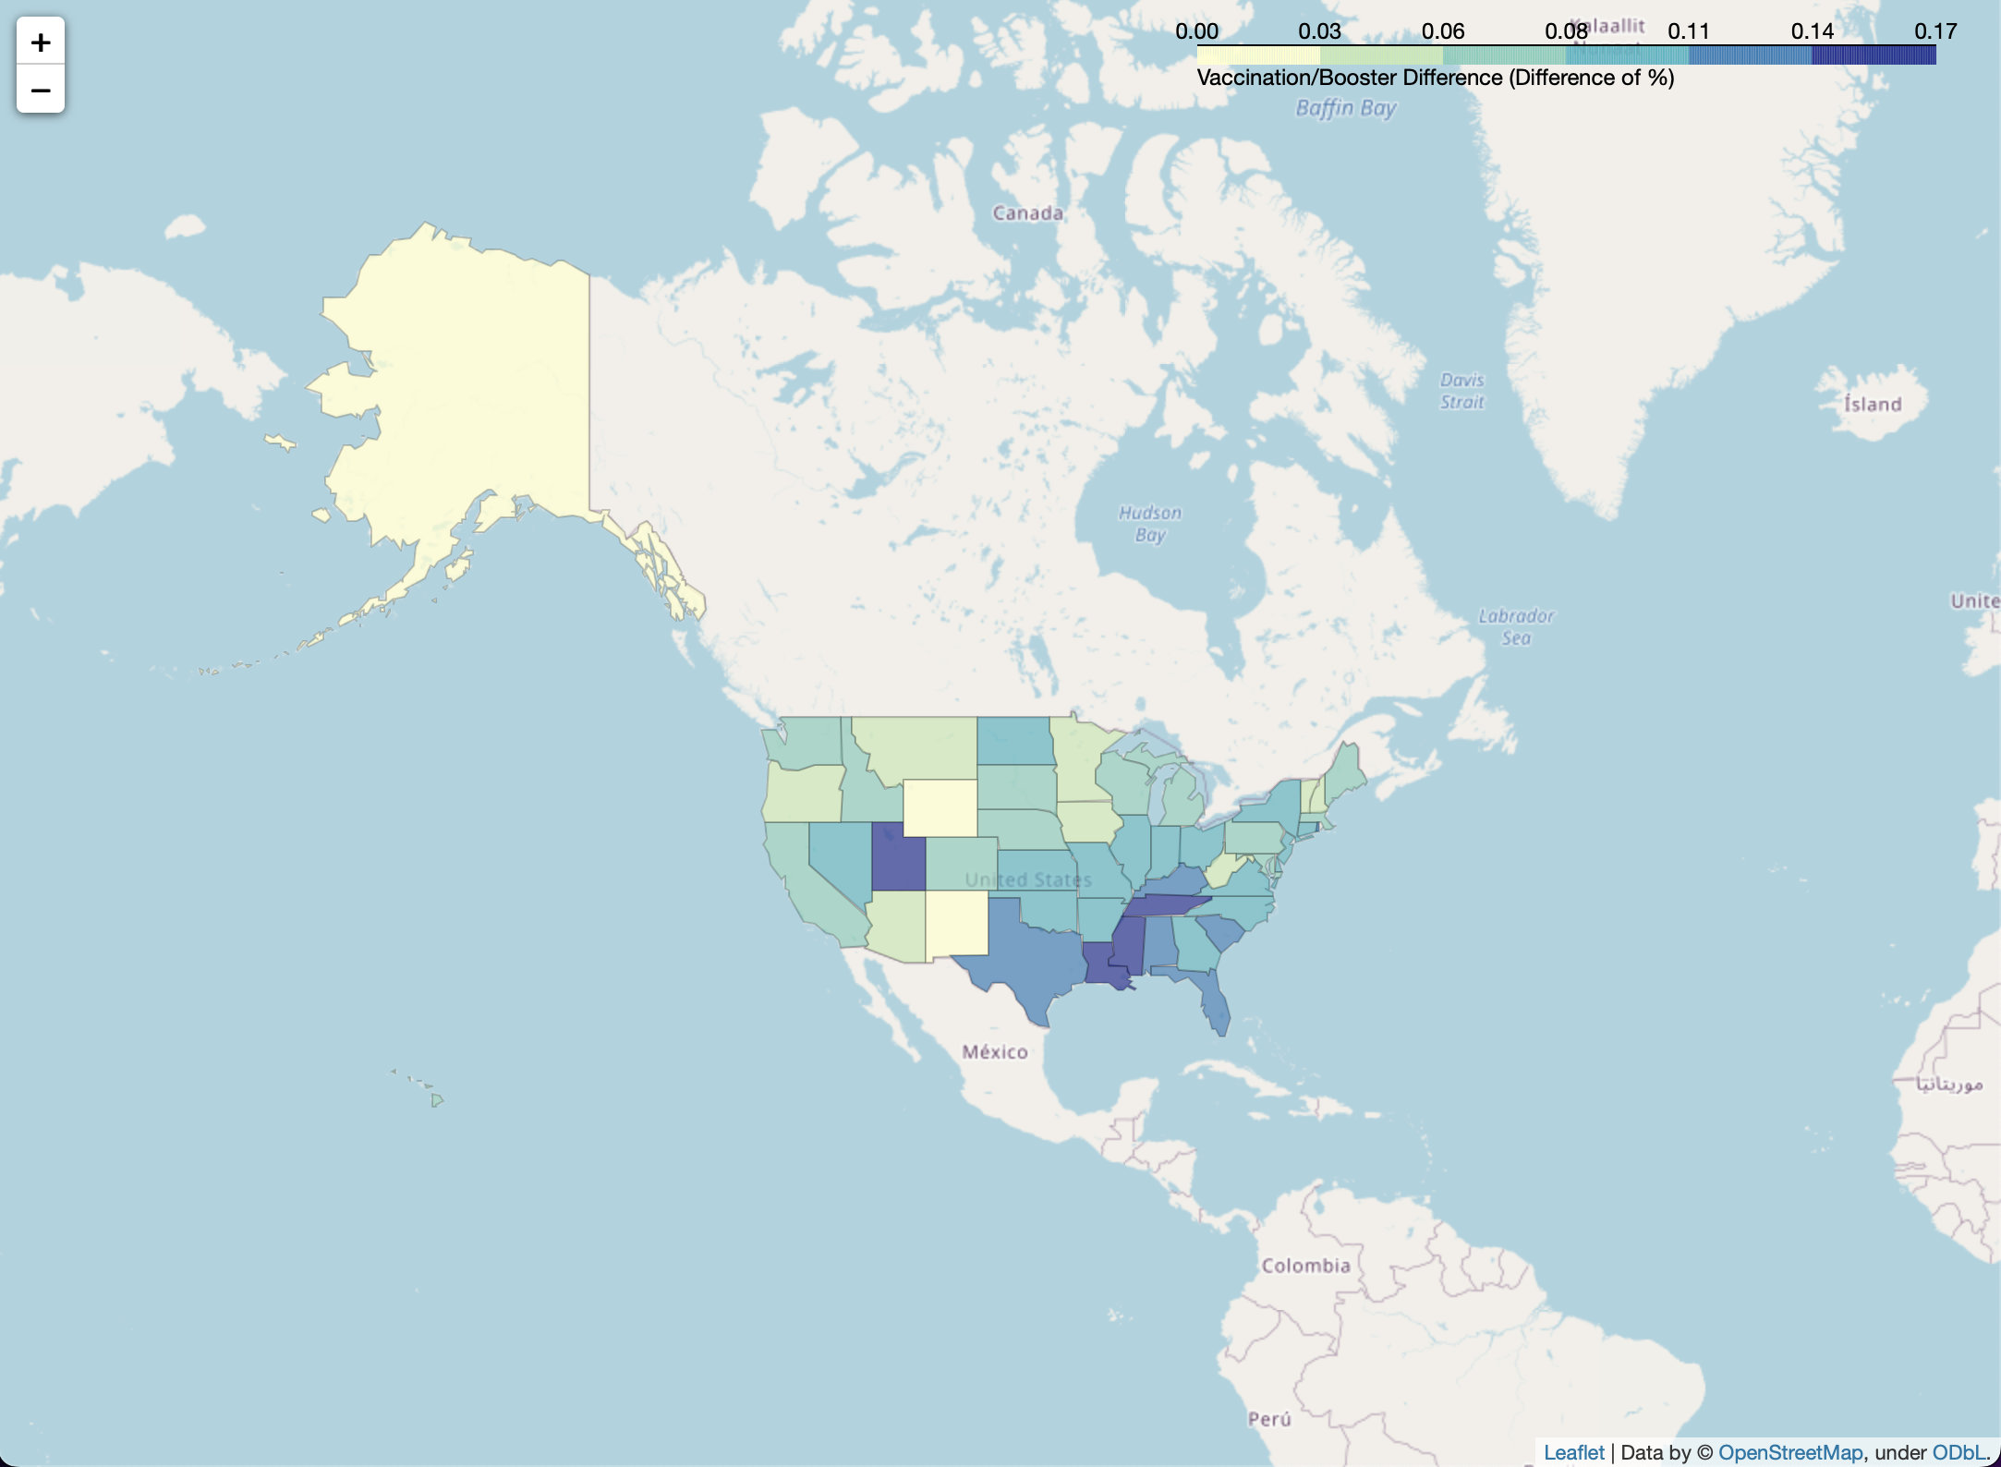

Slide 10
Reasons for no Booster
1: Not eligible 6: Not required (work/school)
2: Plan to get booster 7: Vaccine side effects
3: Unnecessary 8: Cannot get to facility
4: No doctor recommended 9: Other
5: Already had Covid

Slide 11
State Selection
The 4 states with the largest difference based off the 3rd map were Louisiana, Mississippi, Tennessee, and Utah
Graphs were created to visualize the reasons by state

Slide 12
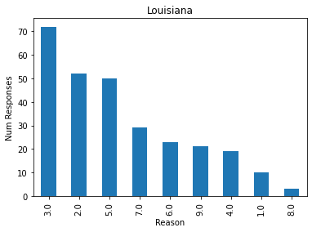
State Graphs

Slide 13
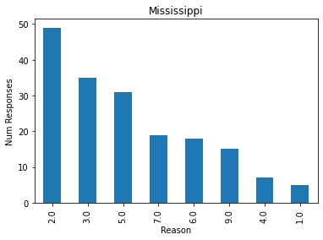
State Graphs

Slide 14
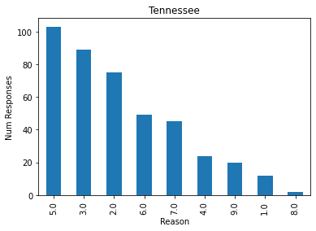
State Graphs

Slide 15
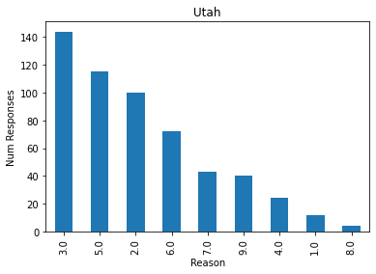
State Graphs

Slide 16
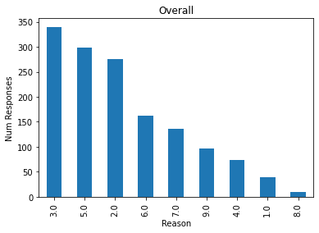
Overall Graph

Slide 17
Conclusions
There appear to be 3 main reasons for not getting the booster

Slide 18
Booster is not Necessary
The main reason with 340 responses was that the booster is not needed
This is not surprising given that there has also been a lot of skepticism towards the original vaccine

Slide 19
Already Had Covid
The second reason with 299 responses was for people who already had covid
The reasoning behind this is that these people have built up antibodies from having the virus that they do not need a booster

Slide 20
Plan to get Booster
The third reason with 276 responses was people who plan to get the booster but have not yet
This makes some sense given the time and potential side effects but given the availability of the booster this is also somewhat confusing.

Slide 21
Overall Conclusion
It appears the main reason for not getting the booster is not believing in its effectiveness, or being too lazy to get it

